Slide 1

ARDIUNO BASED DROWSINESS DETECTION AND ALERTING SYSTEM
MINI PROJECT BY
Vaisakh.M.Nair
[BIOMEDICAL ENGINEERING-3RD YEAR]

Slide 2
Objective
Road accidents became a matter of concern due to the huge increase in traffic.
The primary cause of accidents is due to the drowsiness of drivers in the nighttime.
Fatigue and drowsiness are some of the leading causes of major accidents on Highways.
The only solution to this problem is detecting the drowsiness and alerting the driver.

Slide 3
Materials Required for Building a Drowsiness Detector
Arduino Nano
Eyeblink Sensor
RF Transceiver Module
Buzzer
9V Battery
12V DC power supply

Slide 4
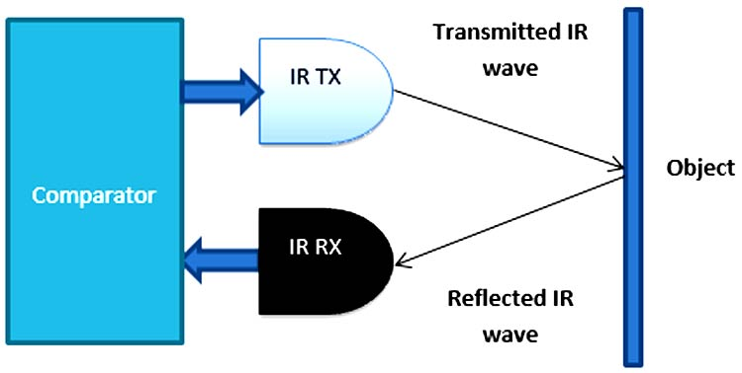
Eye Blink Sensor
The eye blink sensor is used to detect the eye blinks and using which we can also detect the activities like the Drowsiness of the driver while driving. It works based on the technology of Infrared LED. It contains an Infrared transmitter and Receiver LED which is used to detect the eye blink. The working of the simple IR sensor is shown as below:

Slide 5
As shown in the image above, infrared sensors consist of two elements: infrared transmitter which acts as the source, and infrared receiver which acts as the receiver.
Infrared sources include an IR LED and Infrared detectors include photodiodes. The energy emitted by the infrared source is reflected by an object and falls back on the infrared detector.
When the light emitted by the IR LED falls on the receiver, the resistance of the photodiode falls down significantly. This photoreceiver is connected with a potentiometer to form a voltage divider circuit, which gives a variable analog output when blinking activity is detected.
When the incident radiation is more on the photodiode, the voltage drop across the series resistor/Potentiometer will be high. In the Comparator IC which is nothing but an Operational Amplifiers, or Op-amps, both the reference analog voltage and the actual output voltages are compared.
If the voltage across the resistor series to photodiode is greater than that of the reference voltage, the output of the comparator is high, else Low. As the output of the comparator is connected to an LED, it glows when the sensor detects some activity such as eye blinking. The threshold voltage can be adjusted by adjusting the potentiometer depending on the environmental conditions.

Slide 6
433 MHz RF Transceiver Module
The RF stands for Radio Frequency. The corresponding frequency range varies between 30 kHz & 300 GHz. Here we are using a 433 MHz RF Transceiver Module. This RF module comprises a 433 MHz RF Transmitter and RF Receiver.
The transmitter/receiver (Tx/Rx) pair operates at a frequency of 433 MHz. An RF transmitter receives serial data and transmits it wirelessly through RF through its antenna. The transmitted data is received by an RF receiver operating at the same frequency as that of the transmitter.

Slide 7
RF Transmitter
The RF transmitter module uses Amplitude Shift Keying (ASK) and operates at 433MHz. The transmitter module takes serial data input and transmits that signal through RF. The transmitted signals are then received by the receiver module wirelessly.
Ground: Transmitter ground. Connect to the ground plane
Data: Serial data input pin
VCC: Supply voltage; 5V
ANT: Antenna output pin

Slide 8
RF Receiver
The RF receiver module receives the data and sends it to the data OUTPUT pin. The output data can be decoded by the Microcontroller for further action.
Ground: Receiver ground. Connect to the ground plane
Data: Serial data output pin
VCC: Supply voltage; 5V
ANT: Antenna input pin

Slide 9
Result
now it’s time to test the working. First switch on the power in both Transmitter and Receiver sides.
Ensure power is coming at both ends. Wear the Sunglass having eye blink sensor and try blinking eye normally, there should be a LED glowing on the sensor.
If not, then try to vary the potentiometer to change the sensitivity till it detects the eye blink successfully. After successful detection, try for drowsiness by delayed blinking, it should alert by beeping the buzzer.

Slide 10
THANK YOU

